Slide 1
Projects In MongoDB
AngularJS & Mean.js Overview

Slide 2
What is MEAN.js?
A generator for creating MEAN stack applications
Gives us a structure with client/server files
Generate CRUD modules
Uses Mongoose models
Uses AngularJs

Slide 3
MEAN Generator
Generate an app
yo meanjs
Generate a module
yo meanjs:crud-module <module-name>
Generate a route
yo meanjs:angular-route <route-name>
Generate a service
yo meanjs:angular-service <service-name>
Generate a controller
yo meanjs:angular-controller <controller-name>
Generate a view
yo meanjs:angular-view <view-name>

Slide 4
AngularJS Overview
Client side framework
What HTML would have been for apps
Uses controllers & scope
Uses directives similar to Angular 2 (ng-if, ng-repeat, etc)
Great for 2 way data binding

Slide 5
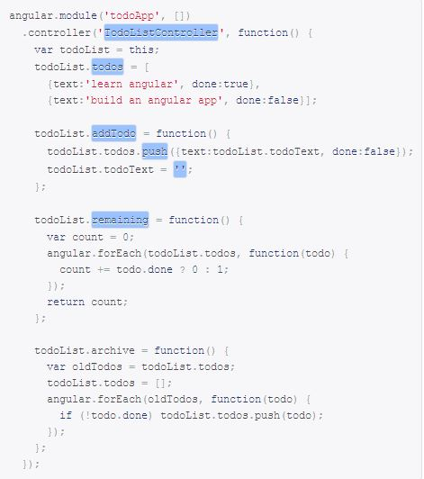
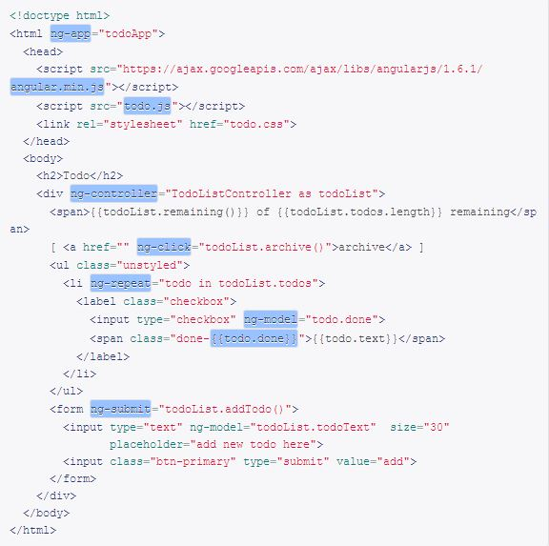

Slide 6


